Slide 1
Philippians 1:18-26
The Future…
Are You Prepared?
Preached by Dan Bridges Amman International Church, Jordan (AmmanChurch.org) Uploaded by Dr. Rick Griffith • Jordan Evangelical Theological Seminary Files in many languages for free download at BibleStudyDownloads.org
Notes:
Preparing for the future is a huge topic in the world today. I did an internet search on preparing for the future, and what do you think is the first topic that popped up? Planning for the future financially!

Slide 2
What would you say are the main things people think about when preparing for the future?

Slide 3
As Believers, the primary way that God wants us to prepare for the future is by learning to love and live for Jesus in every way!

Slide 4
The Gospel in Philippians
God intends for the gospel to transform:
Our Identity (1-2)
Our Relationships (3-8)
Our Prayer (9-11)
How we face difficulty (12-18)
How we see the future (18-26)

Slide 5
Overall Context: Paul’s Personal Update
Verses 12-18a: Paul’s current circumstances
Verses 18b-26: Paul’s perspective on his future

Slide 6
What were Paul’s current circumstances?
Arrested in Jerusalem in ~57AD
Imprisoned in Caesarea for 2 years
Imprisoned in Rome for 2+ years (Acts 28:30)
His trial was coming up soon (“I am confident in the Lord that I myself will come soon.” 2:24)
Two most likely verdicts were release or death!

Slide 7
¹⁸ …Yes, and I will rejoice, ¹⁹ for I know that through your prayers and the help of the Spirit of Jesus Christ this will turn out for my deliverance, ²⁰ as it is my eager expectation and hope that I will not be at all ashamed, but that with full courage now as always Christ will be honored in my body, whether by life or by death. ²¹ For to me to live is Christ, and to die is gain.
Philippians 1:18b-21

Slide 8
²² If I am to live in the flesh, that means fruitful labor for me. Yet which I shall choose I cannot tell. ²³ I am hard pressed between the two. My desire is to depart and be with Christ, for that is far better. ²⁴ But to remain in the flesh is more necessary on your account. ²⁵ Convinced of this, I know that I will remain and continue with you all, for your progress and joy in the faith, ²⁶ so that in me you may have ample cause to glory in Christ Jesus, because of my coming to you again. Philippians 1:22-26

Slide 9
Why?
¹⁸ …Yes, and I will rejoice, ¹⁹ for I know that through your prayers and the help of the Spirit of Jesus Christ this will turn out for my deliverance, ²⁰ as it is my eager expectation and hope that I will not be at all ashamed, but that with full courage now as always Christ will be honored in my body, whether by life or by death. ²¹ For to me to live is Christ, and to die is gain.
Philippians 1:18b-21
?

Slide 10
Why?
¹⁸ …Yes, and I will rejoice, ¹⁹ for I know that through your prayers and the help of the Spirit of Jesus Christ this will turn out for my deliverance, ²⁰ as it is my eager expectation and hope that I will not be at all ashamed, but that with full courage now as always Christ will be honored in my body, whether by life or by death. ²¹ For to me to live is Christ, and to die is gain.
Philippians 1:18b-21
?
Paul’s rejoicing is NOT based on the hope that he will be released!

Slide 11
¹⁸ …Yes, and I will rejoice, ¹⁹ for I know that through your prayers and the help of the Spirit of Jesus Christ this will turn out for my deliverance, ²⁰ as it is my eager expectation and hope that I will not be at all ashamed, but that with full courage now as always Christ will be honored in my body, whether by life or by death. ²¹ For to me to live is Christ, and to die is gain.
Philippians 1:18b-21
Paul’s primary concern???
Whether or not he would honor Christ at his trial!
Notes:
What was Paul’s primary concern – the thing for which he was depending on the Philippians’ prayers and the help of the Holy Spirit?

Slide 12
¹⁸ …Yes, and I will rejoice, ¹⁹ for I know that through your prayers and the help of the Spirit of Jesus Christ this will turn out for my deliverance, ²⁰ as it is my eager expectation and hope that I will not be at all ashamed, but that with full courage now as always Christ will be honored in my body, whether by life or by death. ²¹ For to me to live is Christ, and to die is gain.
Philippians 1:18b-21
Why?
Paul’s rejoicing was in his expectation that Christ would be honored through him!

Slide 13
Paul rejoiced as he pictured Christ being honored through him…
Because Christ was everything to him!
¹⁸ …Yes, and I will rejoice, ¹⁹ for I know that through your prayers and the help of the Spirit of Jesus Christ this will turn out for my deliverance, ²⁰ as it is my eager expectation and hope that I will not be at all ashamed, but that with full courage now as always Christ will be honored in my body, whether by life or by death. ²¹ For to me to live is Christ, and to die is gain.
Philippians 1:18b-21

Slide 14
For to me to live is...
If we say, “For me to live is…”, what do we mean?
We mean there is a supreme thing in our lives – something that dominates and controls everything else.

Slide 15
For to me to live is...
If not Christ, what might that one thing be?
What is living to you? What is the thing of all things to which you hold?
Family
Work
Religious activities
Ministry

Slide 16
Do we love the Gift or the Giver?
When we give a gift – say flowers – why do we do that?
Notes:
When we most love anything other than God, we are loving what he has given us, rather than him.

Slide 17
For to me to live is...
The Bible says, “Love the Lord your God with all your heart, soul, mind and strength.”

Slide 18
For to me to live is...
For Paul, love for Jesus was the one supreme thing – the thing that dominated and controlled every aspect of his life!

Slide 19
How do we Know what we Love?
What do we think about?
What are we interested in?
What are we anxious about?
What do we spend our time doing?
What are our emotions and feelings centered around?

Slide 20
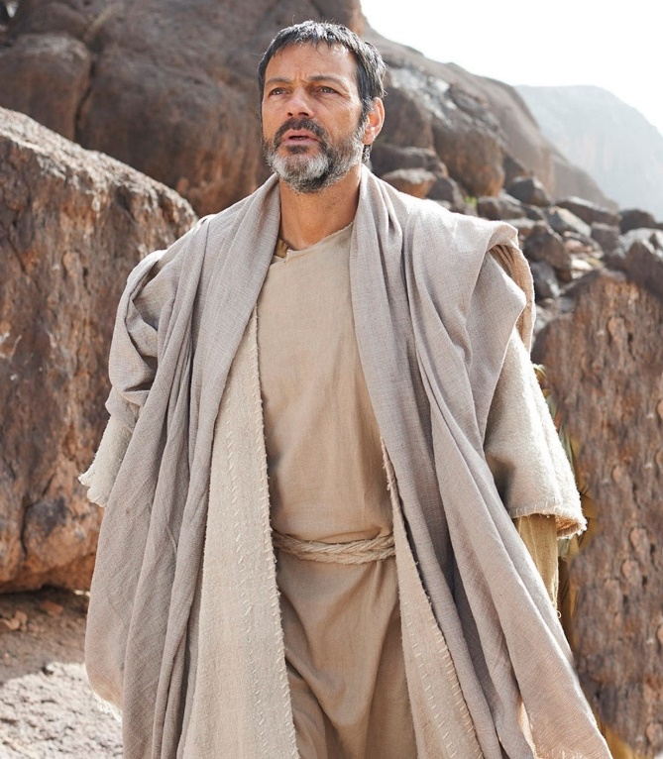
For to me to live is Christ, and to die is gain.
For Paul, living vs. dying was immaterial because either way it meant more of Christ!
Paul had prepared for his future by making Jesus the one thing that his whole life was centered around.

Slide 21
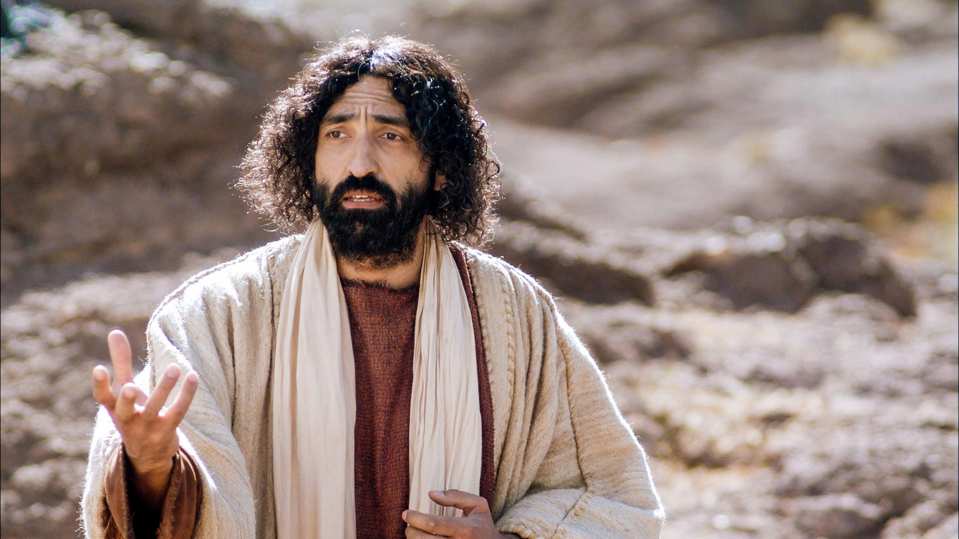
For to me to live is Christ
What specifically did this mean for Paul?
Notes:
If you were walking through the woods and came across a paper which said, “For me to live is art!”, how could you understand that? Were they an artist? Did they collect art? Did they love to teach art? Did they travel the world looking for amazing art? The only way to answer the question would be to find out who wrote it and either interview them or do research on their life.
Fortunately for us, we have lots of Paul’s writings to look at to help us answer this question!

Slide 22
For to me to live is Christ
1. To Love Christ…and to Know His Love!
¹⁴ For this reason I bow my knees before the Father…that you, being rooted and grounded in love, ¹⁸ may have strength to comprehend with all the saints what is the breadth and length and height and depth, ¹⁹ and to know the love of Christ that surpasses knowledge, that you may be filled with all the fullness of God.
Ephesians 3:14,18-19
Notes:
Paul prayed for the Ephesians what he wanted (and had!) in his own life – to be grounded in his love for Christ and to know Christ’s love for himself!

Slide 23
For to me to live is Christ
2. To Live in Communion with Christ
This means he talked with him and meditated on what he is like…
Oh, the depth of the riches of the wisdom and knowledge of God! How unsearchable his judgments, and his paths beyond tracing out!
Romans 11:33

Slide 24
For to me to live is Christ
3. To Devote His Life to His Service
²⁸ He is the one we proclaim, admonishing and teaching everyone with all wisdom, so that we may present everyone fully mature in Christ. ²⁹ To this end I strenuously contend with all the energy Christ so powerfully works in me.
Colossians 1:28-29

Slide 25
For to me to live is Christ
So if Paul continued to live…
To Love Christ…and to Know His Love
To Live in Communion with Christ
To Devote His Life to His Service

Slide 26
And to die is gain
And if Paul died…
To Love Christ…and to Know His Love
…He would love and be loved perfectly!
To Live in Communion with Christ
…He would be actually present with Christ! (v 23)
To Devote His Life to His Service
…He would hear, “Well done, good and
faithful servant!”

Slide 27
What about us? How are our future plans looking?
If we continue to live…
Will we love Christ…and know his love?
Will we live in communion with Christ?
Will we devote our lives to his service?

Slide 28
What about us? How are our future plans looking?
And if we die…Does it seem like gain?
Will we love Christ…and know his love?
…and then love and be loved perfectly!
Will we live in communion with Christ?
…and then be actually present with Christ!
Will we devote our lives to his service?
…and then hear, “Well done, good and
faithful servant!”?

Slide 29
But what if it’s not death God is asking of us?
What if it’s something harder…
1:27 – Standing firm in one spirit, with one mind, striving side by side
1:29 – Called to suffer for the gospel
2:2 – Same mind, same love, in full accord
2:3 – Count others more significant that yourselves
2:4 – Look also to the interests of others
Notes:
It is only in loving Christ supremely that we will be able to do these things!

Slide 30
How do we make this reality in our lives?
If we continue to live…
Will we love Christ…and know his love?
Will we live in communion with Christ?
Will we devote our lives to his service?

Slide 31
How do we make this reality in our lives?
¹² Not that I have already obtained all this, or have already arrived at my goal, but I press on to take hold of that for which Christ Jesus took hold of me. ¹³ Brothers and sisters, I do not consider myself yet to have taken hold of it. But one thing I do: Forgetting what is behind and straining toward what is ahead, ¹⁴ I press on toward the goal to win the prize for which God has called me heavenward in Christ Jesus.
Philippians 3:12-14

Slide 32
Lent 2023
Wed, Mar 1 thru Sat, Apr 15
Ideas for pursuing Jesus during the Lent season:
Fasting from something that you love
Setting aside extra time for God
Asking God to help you see your sin
Repenting and obeying
Asking God for ministry opportunities that require stepping out in faith

Slide 34
NT Preaching link at BibleStudyDownloads.org
Get this presentation for free!
Notes:
NT Preaching (np)

